Slide 1
• Friendship •
Made by:
Ivan van Hese
Lotte van der Schelde
Thyme Kuiters
Isabel Vermeulen

Slide 2
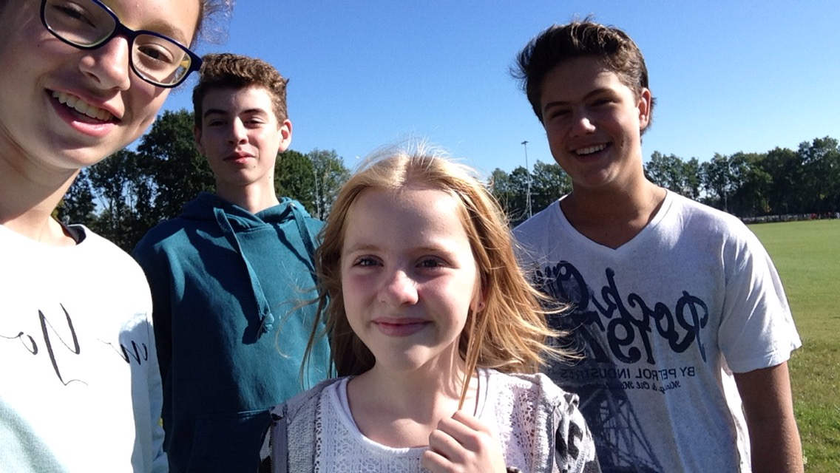
Our team

Slide 3
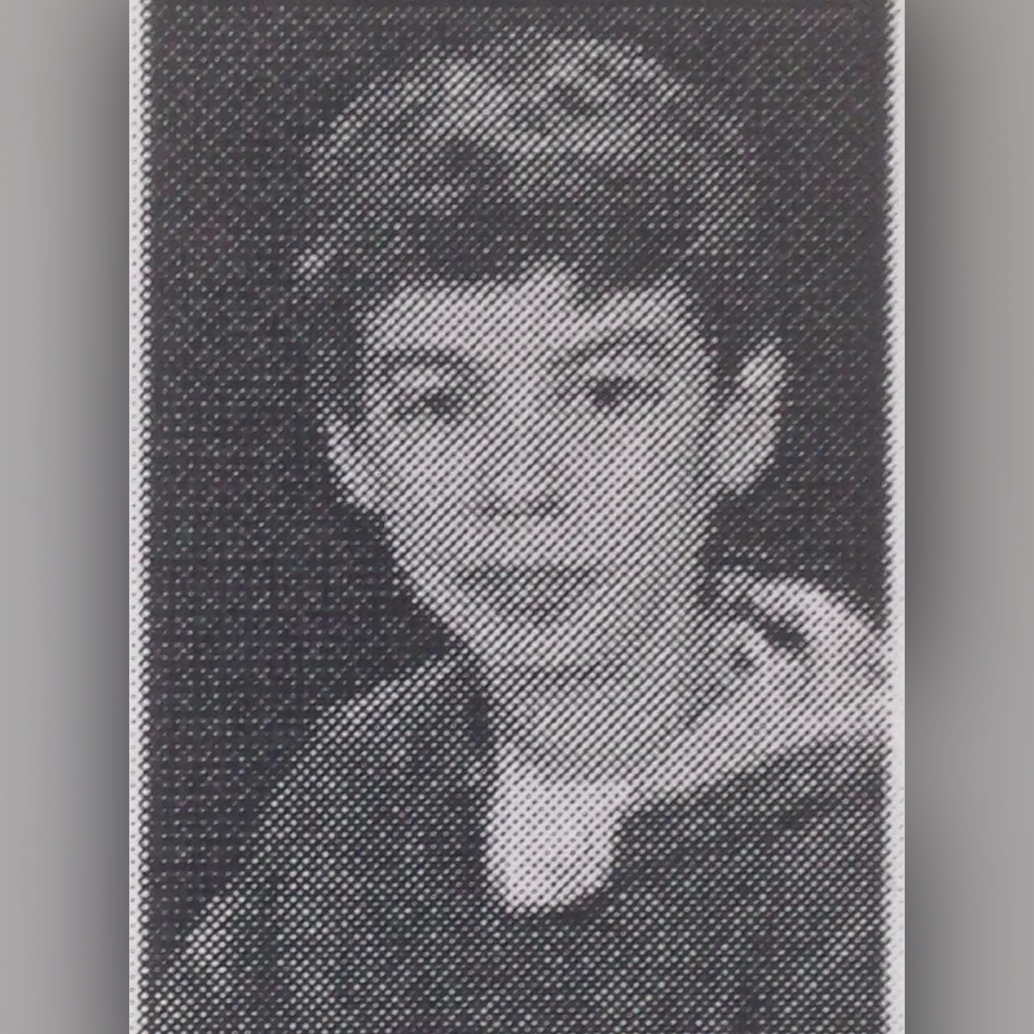
Ivan van Hese
Hi, i'm Ivan i am 13 years old and my hobbies are...

Slide 4
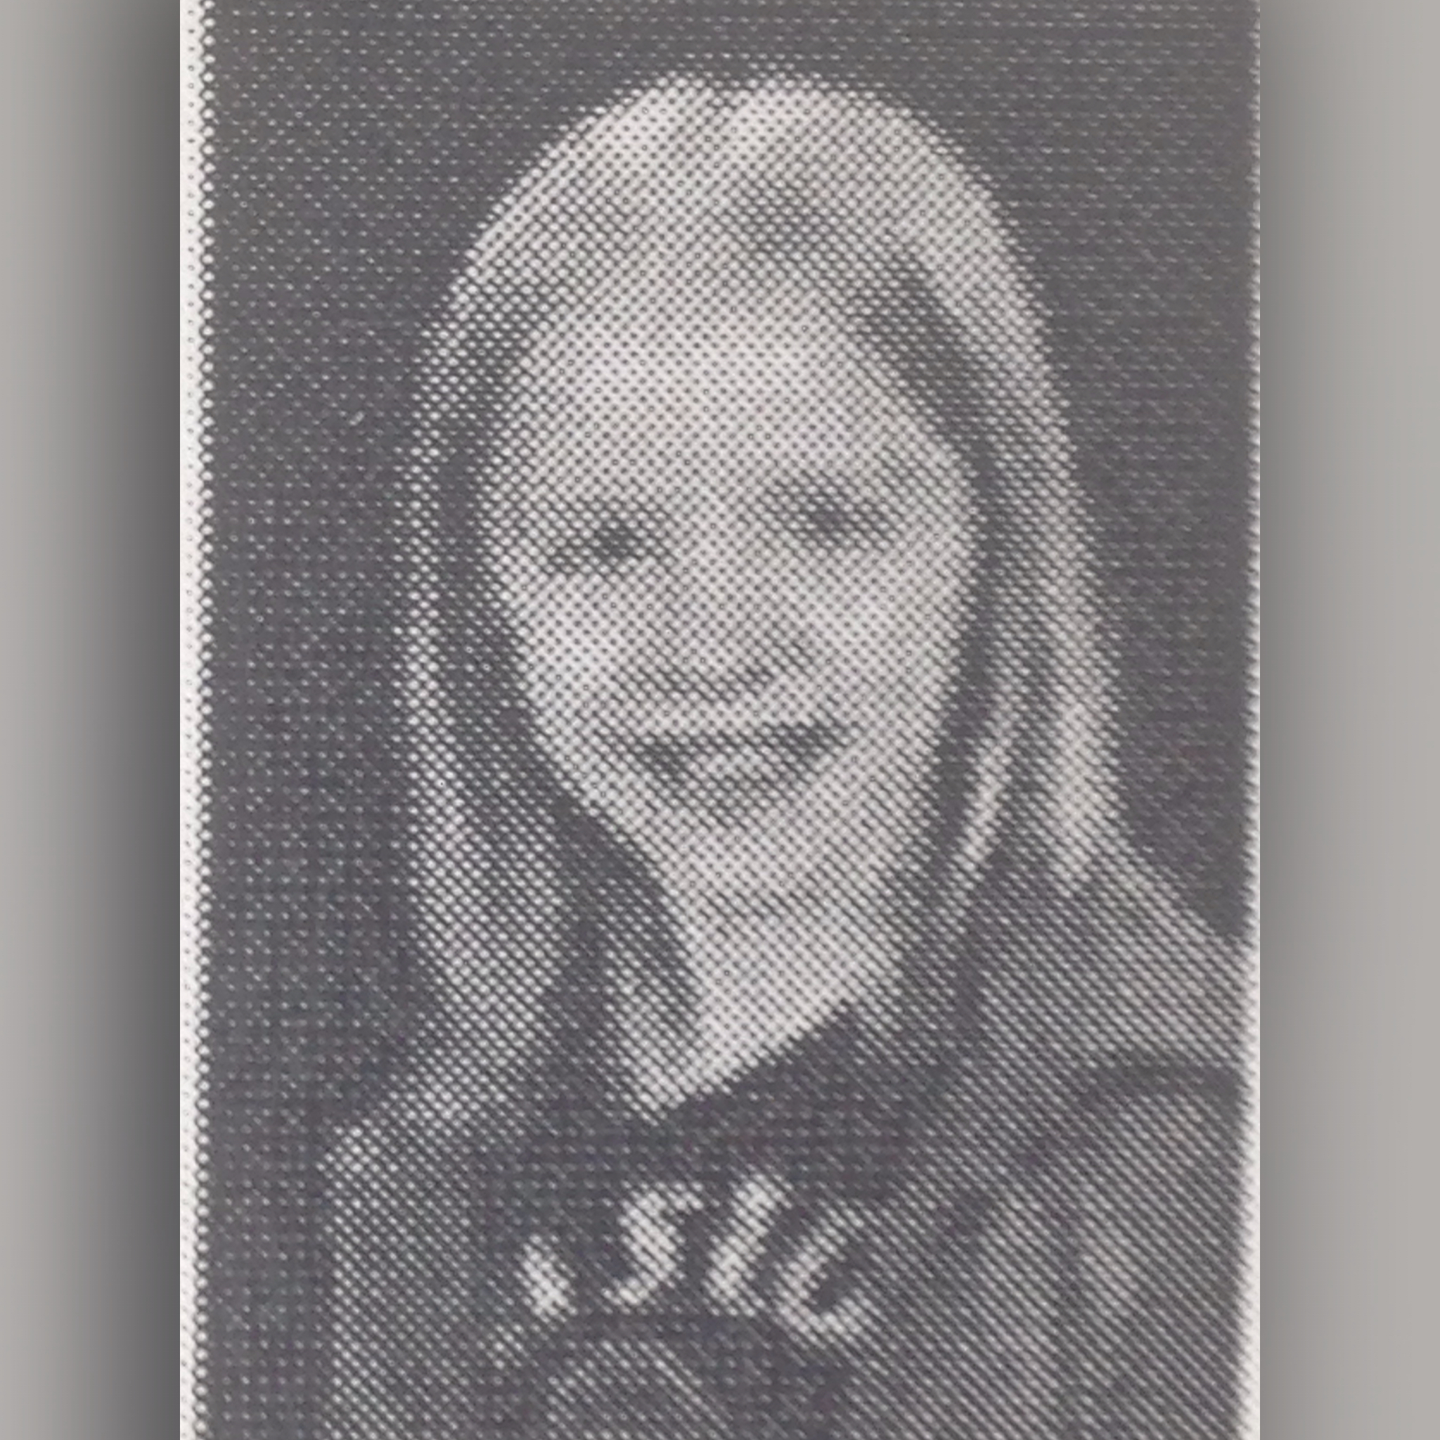
Lotte van der Schelde
Hi, i'm Lotte i'm almost 13 and my hobbies are...

Slide 5
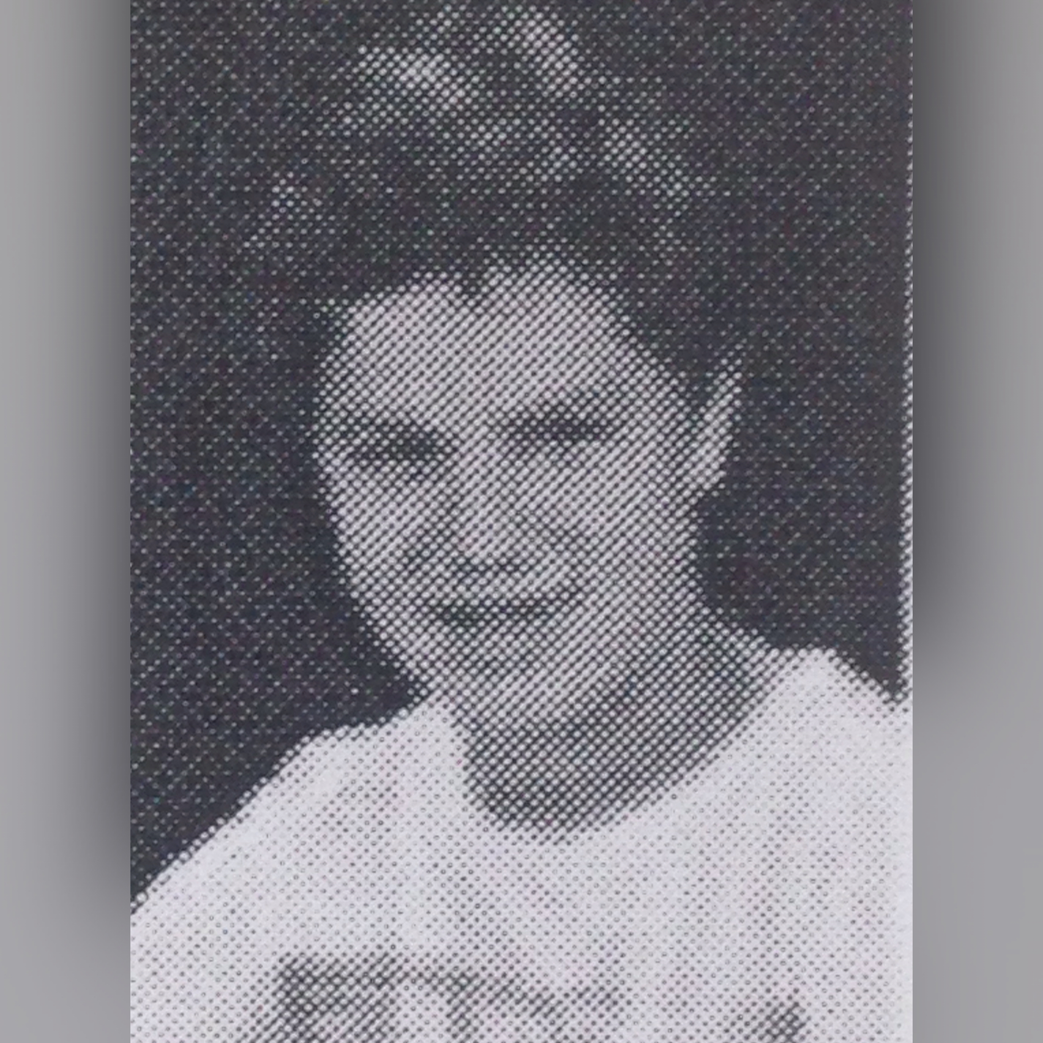
Thyme Kuiters
Hi, i'm Thyme i'm 13 years old and my hobbies are...

Slide 6
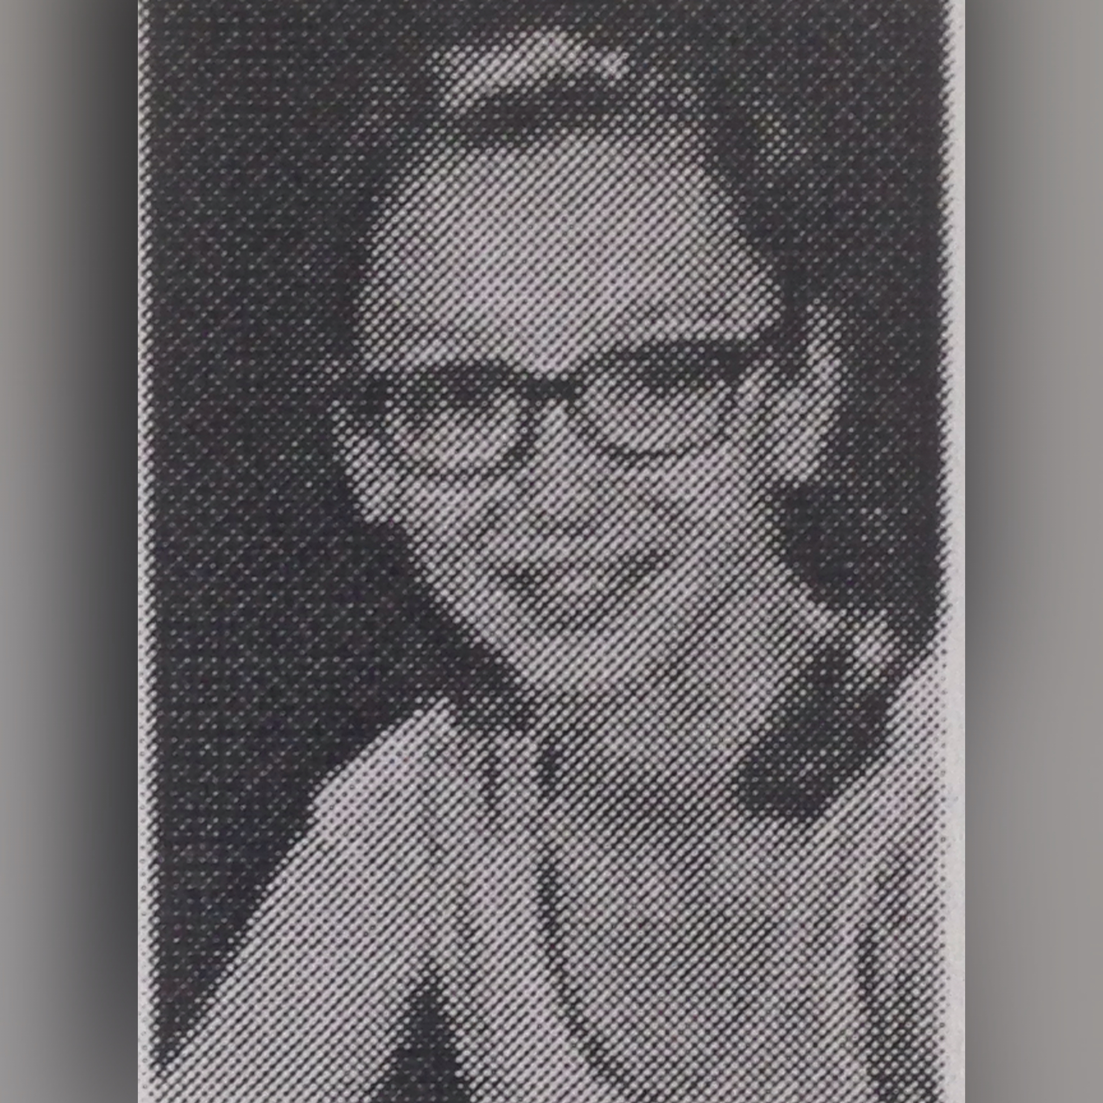
Isabel Vermeulen
Hi, i'm Isabel i'm 13 years old and my hobbies are...

Slide 7
Research question

Slide 8
How important are friends for you??

Slide 9
Having friends was more important when your parents and grandparents had your age??

